Slide 1

Course Management System
Notes:
Hi Everyone,
Good Morning
Before we start with the presentation today, I would like to share a small recital.
We have been a part of Publicis Sapient for almost 3months now, and there is this fact that everyone of us would agree upon.
We all started as fresh graduates, underwent 5weeks or so of rigorous training followed by what…5 weeks now of a Hands On project, and what has transpired in these days is a fact that we all are really proud of. A transformation from someone who could code, to someone who can not only code, but add value to everything he does.
So have we succeeded at becoming a Product engineer?
Hi, I am Rajat, a small part of our big team here.
I am here with my colleagues Aman and Chinmay and we are here to give you a walkthrough of our Transformation, our Journey and the project we have been working for sometime now.

Slide 2
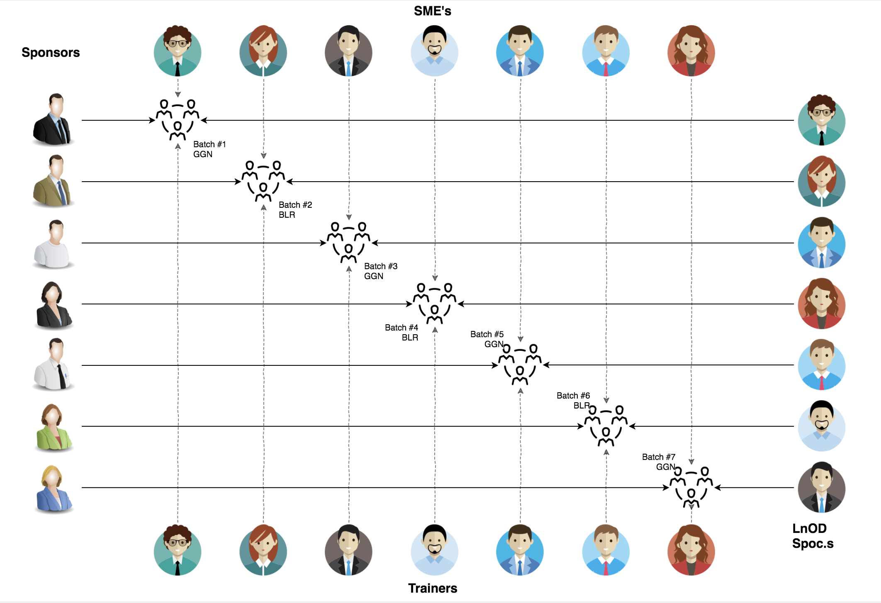
Stakeholders
Sponsors
Flipkart
SME’s
Shree Lakshmi
(Order Trainings)
3. Trainers
Amit Balyan

Slide 3

Agenda
01
Our Journey
02
Our Team
03
Team Structure
04
Problem Statement
05
Engineering Practices
06
Tech Stack
07
Development
08
Demo
09
Challenges & Learnings
10
Questions

Slide 4

Our Journey

Slide 5
ACTION PLAN
 | Modules | Description
Week 1 (Jun13 - Jun’17) | UNIX GIT UML Diagrams | Understanding Unix and Git commands Requirement understanding and diagram design
Week 2 (Jun’20 - Jun’25) | Java 8 Exception Handling SQL Jersey and DropWizard | Developing a POS Application using Java and MySQL. Understanding Java 8 features and collections REST API Development using Jersey and DropWizard framework

Slide 6
Demo
Testing
Process
5
project Demo
Tools
4
Testing on Console, REST client such as Postman
Comprehend
3
Architecture Design and Development
2
Decide the Technology stack for console and REST API development
1
Understanding Project Requirements and Goals

Slide 7
Our next starts
NOW

Slide 8

Our Team

Slide 9
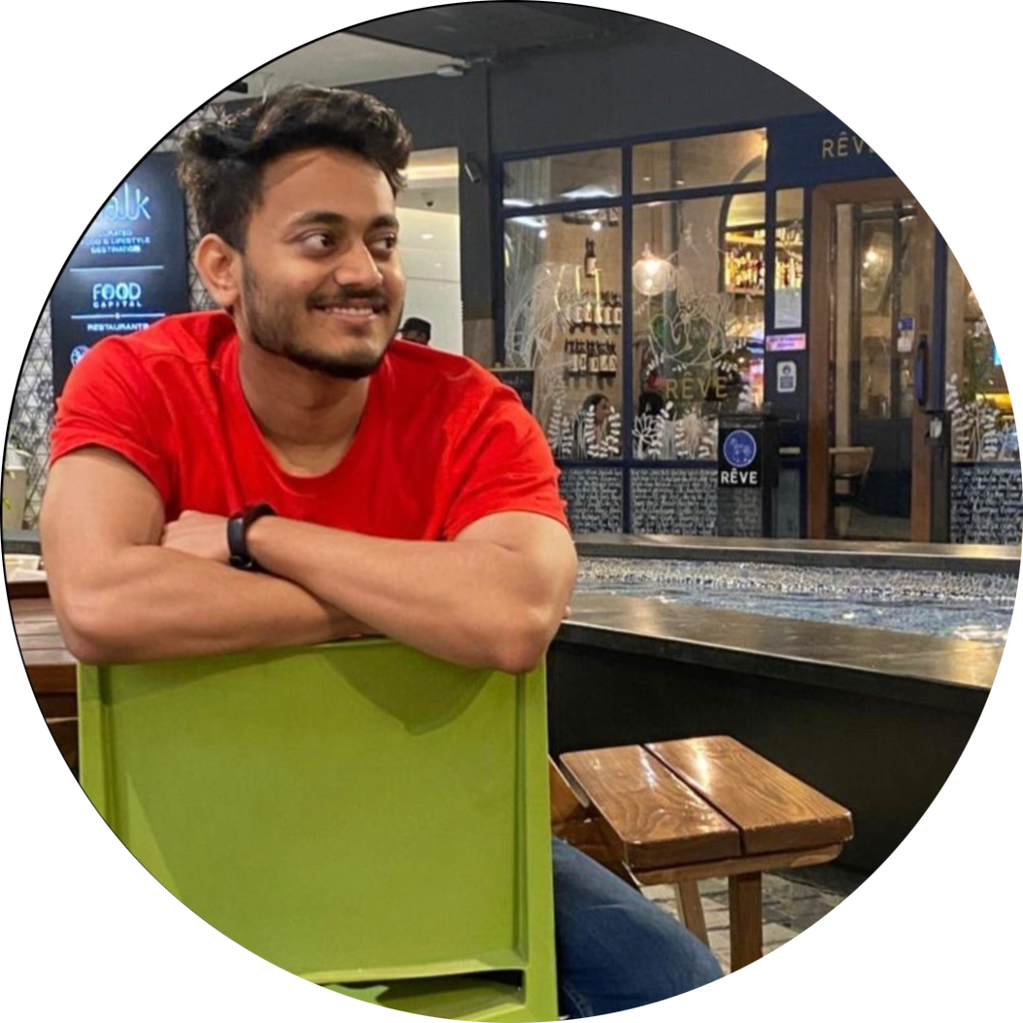
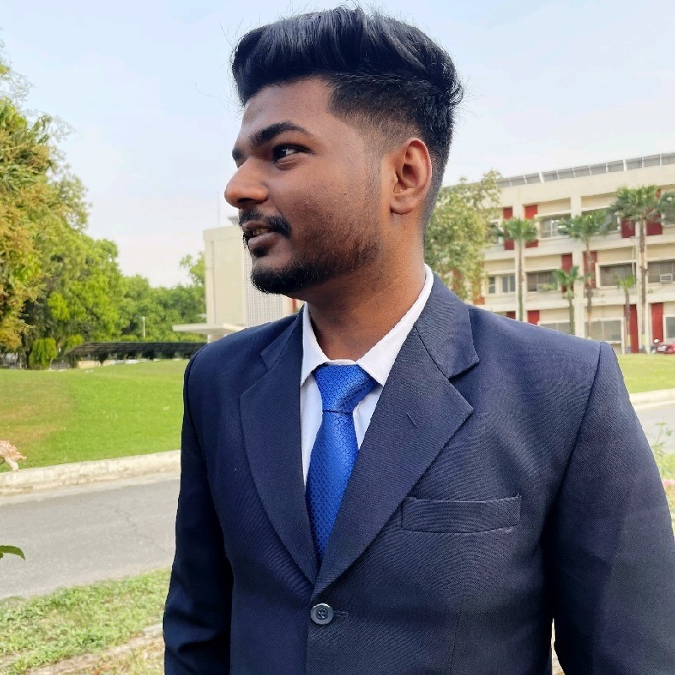
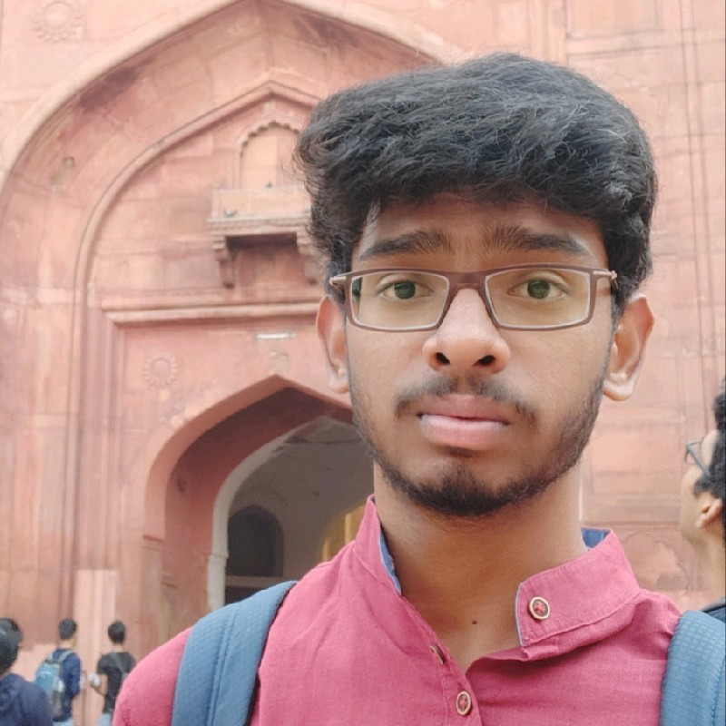


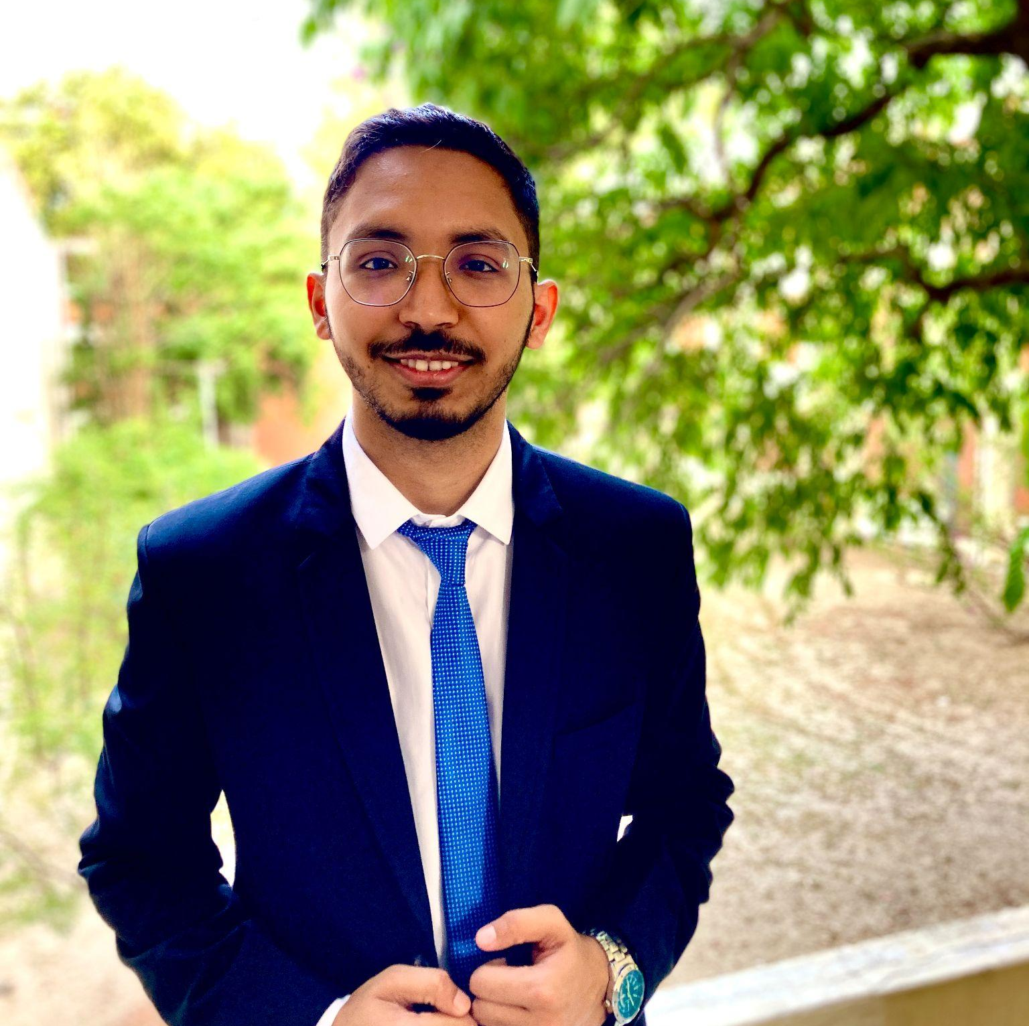
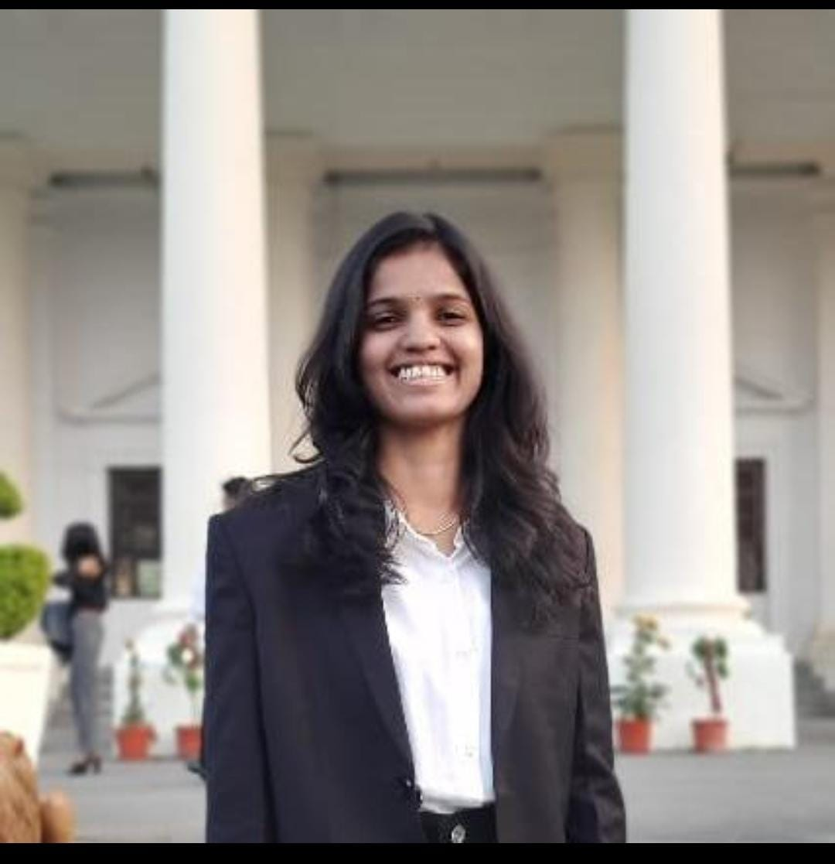
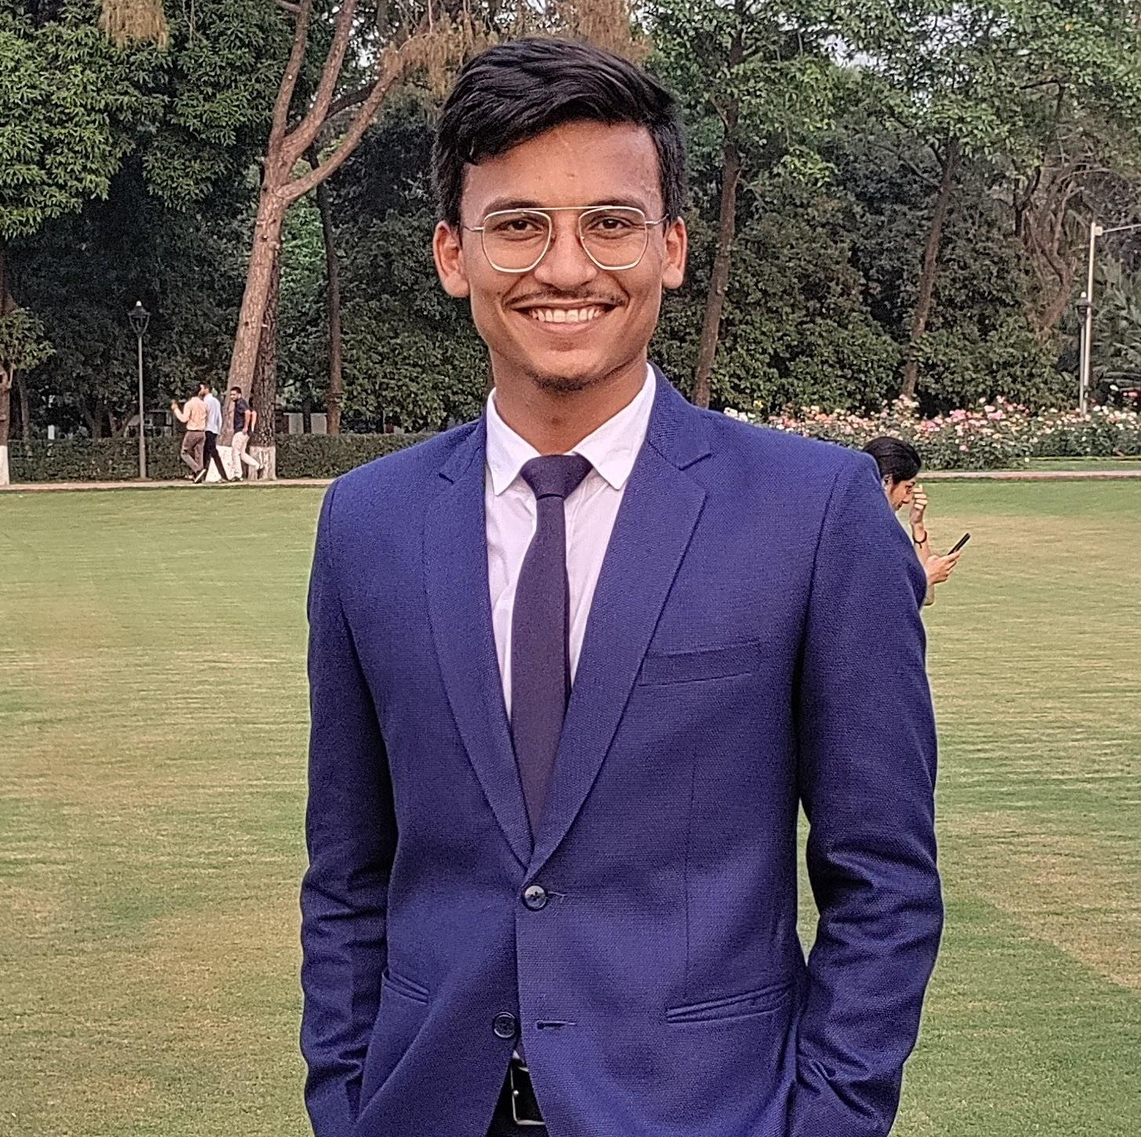
Anand Pandey
Anup Krishna Kumar
Mahidhar Varma B
Aryan Nair
Anubhuti Srivastava
Divij Jain
Banda Sahithi
Anadi Vyas

Slide 10
Name | Responsibility
Anadi and Divij | Use Case Diagrams of Admin, Professor and Student
Anup and Mahidhar | Class Diagrams of Admin, Professor and Student
Aryan Nair | Activity Diagrams of Admin, Professor and Student
Anubhuti Srivastava | Sequence Diagrams of Admin, Professor and Student
Banda Sahithi | JavaDoc Generation and following best coding practices
Anand Pandey | POS & Dropwizard Integration

Slide 11

Project Goals

Slide 12




Problem Statement
To develop a POS application and REST API for Course Registration System using JAVA where the student can register, add/drop course, professors can view courses, enrolled students while admin can manage users, add/drop courses to catalog
1
2
Quality
Security
3
4
Interactivity
Speed
Notes:
I was given the responsibility about java doc generation and ensuring my team to follow best coding practices for generating codes from class diagrams

Slide 13

Engineering Practices

Slide 14

Requirement Gathering
Tech Stack Selection
UML Artifacts, Architecture Design
Code development

Slide 15

Tech Stack

Slide 16














Designing
Backend
Testing
Data
SCM
UML
Core Language
Tools
SQL Database
Code Collaboration
ID
Framework
Application Server

Slide 17
UML Diagrams
Use Case diagram
Class diagram
Activity diagram
Sequence diagram

Slide 18

Architecture Design

Slide 19


POS Application
Java Main Client
Service Layer
Database Layer
HTTP Request
HTTP Response
N-Tier Architecture

Slide 20

Demo

Slide 21

Challenges & Learnings

Slide 22
 | Challenges | Learning
Week 1 | Getting accustomed to MacOS Understanding the problem statement Installation of required softwares such as Java, Git Collaboration issues such as merge conflicts in Git UML diagram conventions | MacOS UNIX Git commands UML Diagrams
Week 2 | POS application development using layered architecture SQL constraints and commands Resolving jar and version dependencies Jersey validation | Java 8 Exception Handling SQL REST API development using Jersey and DropWizard Maven DropWizard

Slide 23

Questions

Slide 24
Thank you

